Slide 1
Module #13:
Recursion
26年 11月 8日
©2001-2004 Michael P. Frank, revised by S. Kang

Slide 2
§3.4: Recursive Definitions
In induction, we prove all members of an infinite set satisfy some predicate P by:
  proving the truth of the predicate for larger members in terms of that of smaller members.
In recursive definitions, we similarly define a function, a predicate, a set, or a more complex structure over an infinite domain (universe of discourse) by:
  defining the function, predicate value, set membership, or structure of larger elements in terms of those of smaller ones.
In structural induction, we inductively prove properties of recursively-defined objects in a way that parallels the objects’ own recursive definitions.
26年 11月 8日
©2001-2004 Michael P. Frank, revised by S. Kang

Slide 3
Recursion
Recursion is the general term for the practice of defining an object in terms of itself
  or of part of itself
  This may seem circular, but it isn’t necessarily.
An inductive proof establishes the truth of P(n+1) recursively in terms of P(n).
There are also recursive algorithms, definitions, functions, sequences, sets, and other structures.
26年 11月 8日
©2001-2004 Michael P. Frank, revised by S. Kang

Slide 4
Recursively Defined Functions
Simplest case: One way to define a function f:N→S (for any set S) or series a_{n}=f(n) is to:
  Define f(0).
  For n>0, define f(n) in terms of f(0),…,f(n−1).
E.g.: Define the series a_{n} :≡ 2^{n} recursively:
  Let a₀ :≡ 1.
  For n>0, let a_{n} :≡ 2a_{n-1}.
26年 11月 8日
©2001-2004 Michael P. Frank, revised by S. Kang

Slide 5
Another Example
Suppose we define f(n) for all n∈N recursively by:
  Let f(0)=3
  For all n∈N, let f(n+1)=2f(n)+3
What are the values of the following?
  f(1)= f(2)= f(3)= f(4)=
9
21
45
93
26年 11月 8日
©2001-2004 Michael P. Frank, revised by S. Kang

Slide 6
Recursive definition of Factorial
Give an inductive (recursive) definition of the factorial function,
F(n) :≡ n! :≡ ∏_{1≤i≤n} i = 1⋅2⋅…⋅n.
  Base case: F(0) :≡ 1
  Recursive part: F(n) :≡ n ⋅ F(n−1).
    F(1)=1
    F(2)=2
    F(3)=6
26年 11月 8日
©2001-2004 Michael P. Frank, revised by S. Kang

Slide 7
More Easy Examples
Write down recursive definitions for:
  a·n (a real, n natural) using only addition
  a^{n} (a real, n natural) using only multiplication
  ∑_{0≤i≤n} a_{i} (for an arbitrary series of numbers {a_{i}})
  ∏_{0≤i≤n} a_{i} (for an arbitrary series of numbers {a_{i}})
  ∩_{0≤i≤n} S_{i} (for an arbitrary series of sets {S_{i}})
26年 11月 8日
©2001-2004 Michael P. Frank, revised by S. Kang

Slide 8
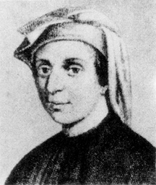
The Fibonacci Series
The Fibonacci series f_{n≥0} is a famous series defined by:
f₀ :≡ 0, f₁ :≡ 1, f_{n≥2} :≡ f_{n−1} + f_{n−2}
0
1
1
2
3
5
8
13
Leonardo Fibonacci
1170-1250
26年 11月 8日
©2001-2004 Michael P. Frank, revised by S. Kang

Slide 9
Inductive Proof about Fib. series
Theorem: f_{n} < 2^{n}.
Proof: By induction.
Base cases: f₀ = 0 < 2⁰ = 1
f₁ = 1 < 2¹ = 2
Inductive step: Use 2nd principle of induction
(strong induction). Assume ∀k<n, f_{k} < 2^{k}.
Then f_{n} = f_{n−1} + f_{n−2} is
< 2^{n−1} + 2^{n−2} < 2^{n−1} + 2^{n−1} = 2^{n}. ■
Implicitly for all n∈N
Note use of
base cases of
recursive def’n.
26年 11月 8日
©2001-2004 Michael P. Frank, revised by S. Kang

Slide 10
A lower bound on Fibonacci series
Theorem. For all integers n ≥ 3, f_{n} > α^{n−2}, where α = (1+5^{1/2})/2 ≈ 1.61803.
Proof. (Using strong induction.)
  Let P(n) = (f_{n} > α^{n−2}).
  Base cases: For n=3, note that α < 2 = f₃. For n=4, α² = (1+2·5^{1/2}+5)/4 = (3+5^{1/2})/2 ≈ 2.61803 < 3 = f₄.
  Inductive step: For k≥4, assume P(j) for 3≤j≤k, prove P(k+1). Note α² = α+1. Thus, α^{k−1} = (α+1)α^{k−3} = α^{k−2} + α^{k−3}. By inductive hypothesis, f_{k−1} > α^{k−3} and f_{k} > α^{k−2}. So, f_{k+1} = f_{k} + f_{k−1} > α^{k−2} + α^{k−3} = α^{k−1}. Thus P(k+1). ■
26年 11月 8日
©2001-2004 Michael P. Frank, revised by S. Kang

Slide 11
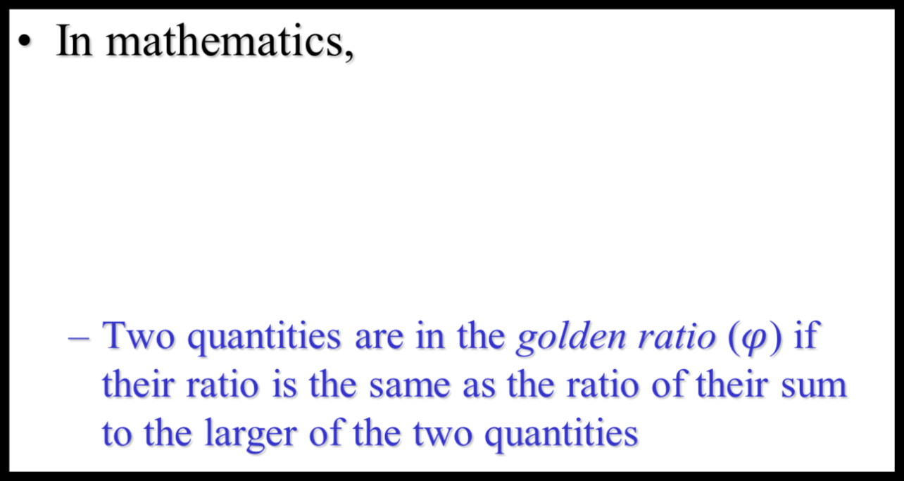
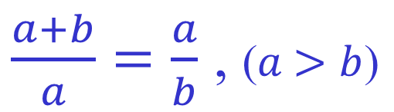
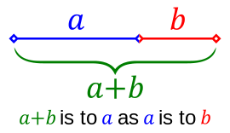
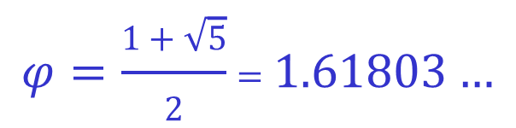
Golden Ratio
26年 11月 8日
©2001-2004 Michael P. Frank, revised by S. Kang

Slide 12
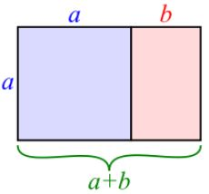
Golden Ratio
Golden rectangle
26年 11月 8日
©2001-2004 Michael P. Frank, revised by S. Kang

Slide 13
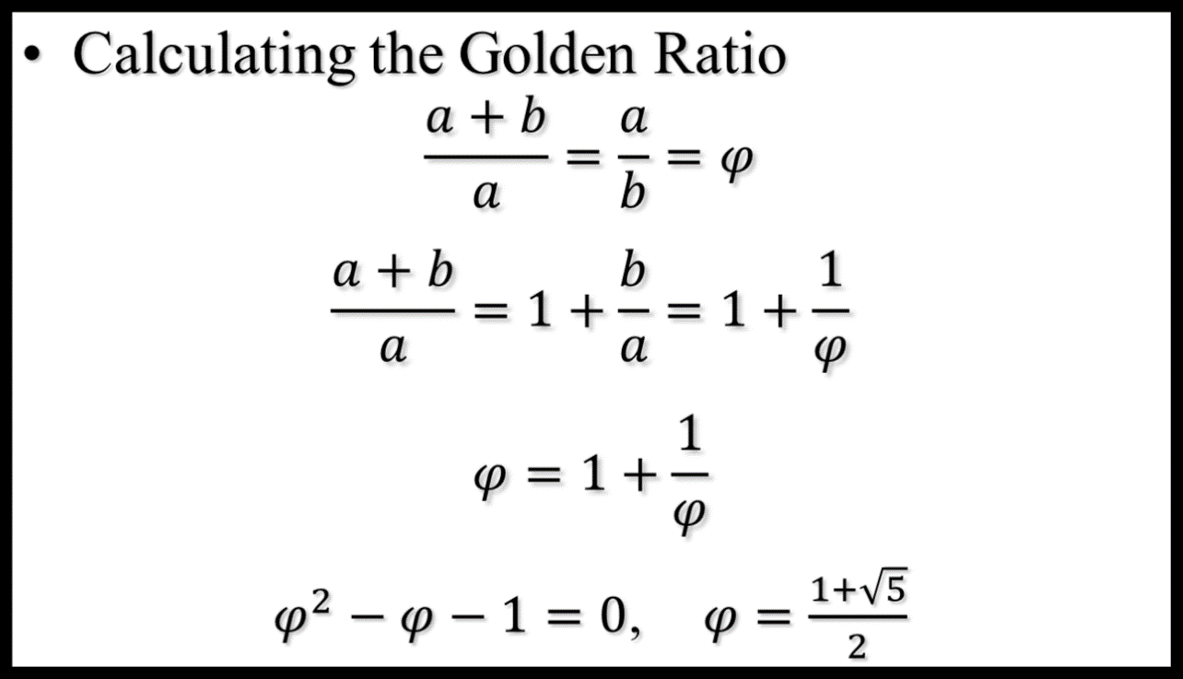
Golden Ratio
26年 11月 8日
©2001-2004 Michael P. Frank, revised by S. Kang

Slide 14
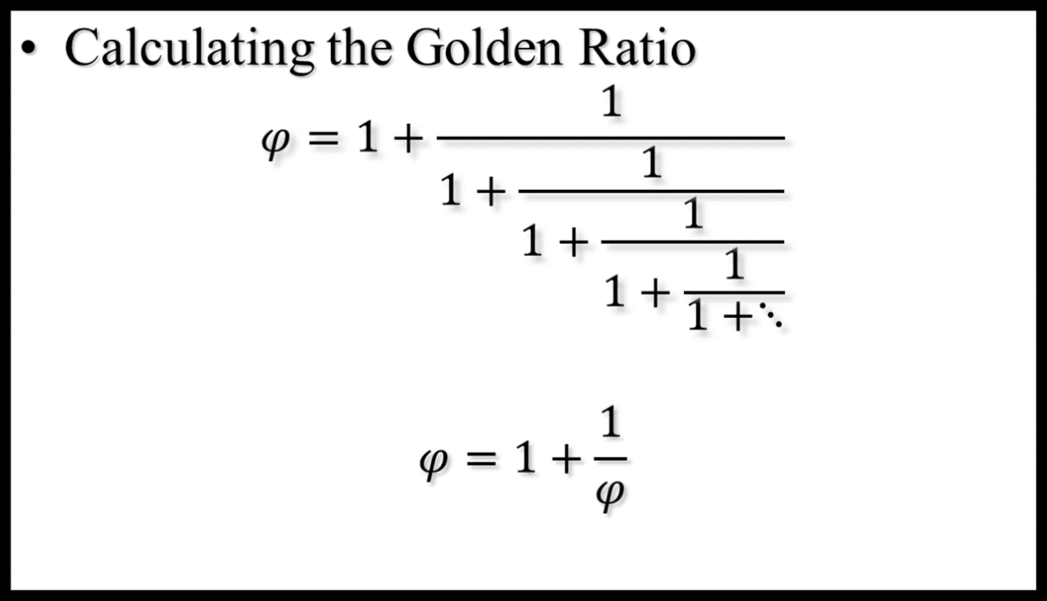

Golden Ratio
26年 11月 8日
©2001-2004 Michael P. Frank, revised by S. Kang

Slide 15
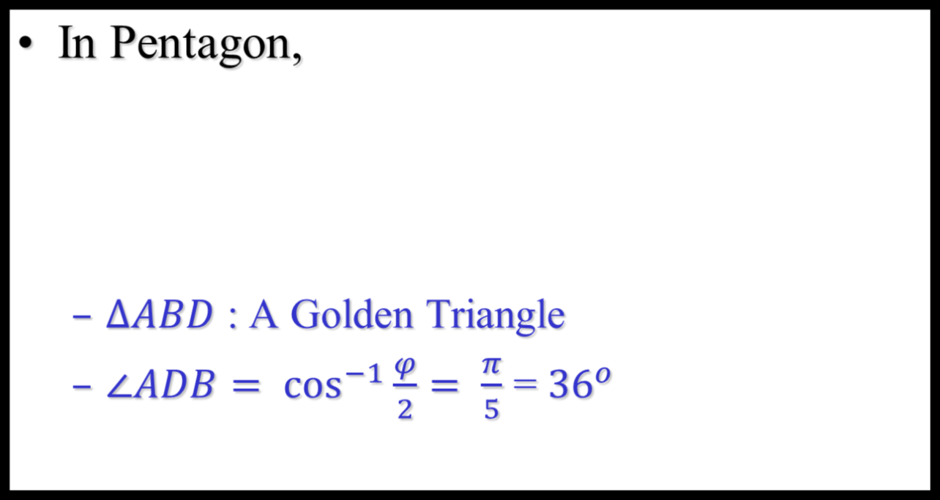
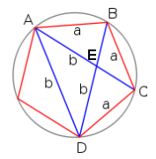
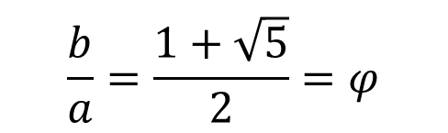
Golden Ratio
26年 11月 8日
©2001-2004 Michael P. Frank, revised by S. Kang

Slide 16
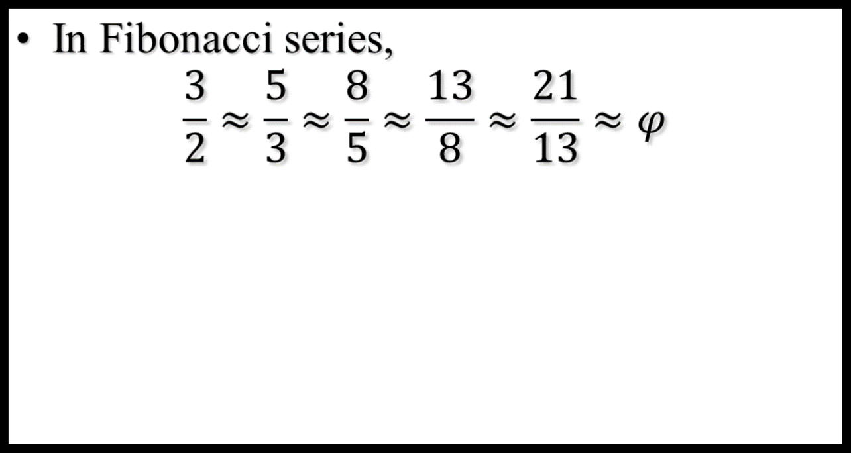
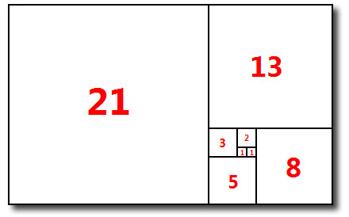
Golden Ratio
Fibonacci series continuously forms the golden rectangle!
26年 11月 8日
©2001-2004 Michael P. Frank, revised by S. Kang

Slide 17
Recursively Defined Sets
An infinite set S may be defined recursively, by giving:
  A small finite set of base elements of S.
  A rule for constructing new elements of S from previously-established elements.
  Implicitly, S has no other elements but these.
Example: Let 3∈S, and let x+y∈S if x,y∈S.
What is S?
26年 11月 8日
©2001-2004 Michael P. Frank, revised by S. Kang

Slide 18
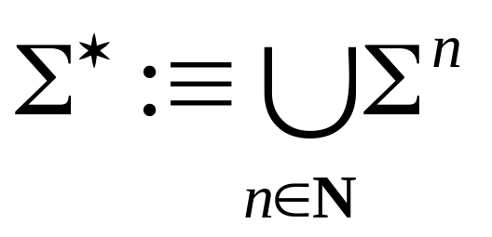
The Set of All Strings
Given an alphabet Σ, the set Σ* of all strings over Σ can be recursively defined by:
ε ∈ Σ* (ε :≡ “”, the empty string)
w ∈ Σ* ∧ x ∈ Σ → wx ∈ Σ*
This definition is equivalent to our old one:
Book
uses λ
26年 11月 8日
©2001-2004 Michael P. Frank, revised by S. Kang

Slide 19
Rooted Trees
Trees will be covered in more depth in DS course.
  Briefly, a tree is a graph in which there is exactly one undirected path between each pair of nodes.
  An undirected graph can be represented as a set of unordered pairs (called arcs) of objects called nodes.
Definition of the set of rooted trees:
  Any single node r is a rooted tree.
  If T₁, …, T_{n} are disjoint rooted trees with respective roots r₁, …, r_{n}, and r is a node not in any of the T_{i}’s, then another rooted tree is {{r,r₁},…,{r,r_{n}}}∪T₁∪…∪T_{n}.
26年 11月 8日
©2001-2004 Michael P. Frank, revised by S. Kang

Slide 20
Illustrating Rooted Tree Def’n.
How rooted trees can be combined to form a new rooted tree…
r
…
T₁
r₁
T₂
r₂
T_{n}
r_{n}
26年 11月 8日
©2001-2004 Michael P. Frank, revised by S. Kang

Slide 21
Structural Induction
Proving something about a recursively defined object using an inductive proof whose structure mirrors the object’s definition.
Example problem: Let 3∈S, and let x+y∈S if x,y∈S. Show that S = {n∈Z⁺| (3|n)} (the set of positive multiples of 3).
26年 11月 8日
©2001-2004 Michael P. Frank, revised by S. Kang

Slide 22
Example continued
Let 3∈S, and let x+y∈S if x,y∈S. Let A = {n∈Z⁺| (3|n)}.
Theorem: A=S. Proof: We show that A⊆S and S⊆A.
  To show A⊆S, show [n∈Z⁺ ∧ (3|n)]→ n∈S.
    Inductive proof. Let P(n) :≡ n∈S. Induction over positive multiples of 3. Base case: n=3, thus 3∈S by def’n. of S. Inductive step: Given P(n), prove P(n+3). By inductive hyp., n∈S, and 3∈S, so by def’n of S, n+3∈S.
  To show S⊆A: let n∈S, show n∈A.
    Structural inductive proof. Let P(n):≡n∈A. Two cases: n=3 (base case), which is in A, or n=x+y (recursive step). We know x and y are positive, since neither rule generates negative numbers. So, x<n and y<n, and so we know x and y are in A, by strong inductive hypothesis. Since 3|x and 3|y, we have 3|(x+y), thus x+y ∈ A.
26年 11月 8日
©2001-2004 Michael P. Frank, revised by S. Kang

Slide 23
Recursive Algorithms (§3.5)
Recursive definitions can be used to describe algorithms as well as functions and sets.
Example: A procedure to compute a^{n}.
procedure power(a≠0: real, n∈N)
if n = 0 then return 1
else return a · power(a, n−1)
26年 11月 8日
©2001-2004 Michael P. Frank, revised by S. Kang

Slide 24
Efficiency of Recursive Algorithms
The time complexity of a recursive algorithm may depend critically on the number of recursive calls it makes.
Example: Modular exponentiation to a power n can take log(n) time if done right, but linear time if done slightly differently.
  Task: Compute b^{n} mod m, where
  m≥2, n≥0, and 1≤b<m.
26年 11月 8日
©2001-2004 Michael P. Frank, revised by S. Kang

Slide 25
Modular Exponentiation Alg. #1
Uses the fact that b^{n} = b·b^{n−1} and that
x·y mod m = x·(y mod m) mod m.
(Prove the latter theorem at home.)
procedure mpower(b≥1,n≥0,m>b ∈N)
{Returns b^{n} mod m.}
if n=0 then return 1 else
return (b·mpower(b,n−1,m)) mod m
Note this algorithm takes Θ(n) steps!
26年 11月 8日
©2001-2004 Michael P. Frank, revised by S. Kang

Slide 26
Modular Exponentiation Alg. #2
Uses the fact that b^{2k} = b^{k·2} = (b^{k})².
procedure mpower(b,n,m) {same signature}
if n=0 then return 1
else if 2|n then
return mpower(b,n/2,m)² mod m
else return (mpower(b,n−1,m)·b) mod m
What is its time complexity?
Θ(log n) steps
26年 11月 8日
©2001-2004 Michael P. Frank, revised by S. Kang

Slide 27
A Slight Variation
Nearly identical but takes Θ(n) time instead!
procedure mpower(b,n,m) {same signature}
if n=0 then return 1
else if 2|n then
return (mpower(b,n/2,m)·
mpower(b,n/2,m)) mod m
else return (mpower(b,n−1,m)·b) mod m
The number of recursive calls made is critical!
26年 11月 8日
©2001-2004 Michael P. Frank, revised by S. Kang

Slide 28
Recursive Euclid’s Algorithm
procedure gcd(a,b∈N)
if a = 0 then return b
else return gcd(b mod a, a)
Note recursive algorithms are often simpler to code than iterative ones…
However, they can consume more stack space, if your compiler is not smart enough.
26年 11月 8日
©2001-2004 Michael P. Frank, revised by S. Kang

Slide 29
Recursive Linear Search
Note there is no real advantage to using recursion here, rather than just looping for loc := i to j…
procedure search(a: series; i, j: integer;
x: item to be found)
{Find x in series a at a location ≥i and <j}
if a_{i} = x return i {At the first item? Return it!}
if i = j return 0 {No locations in range? Failure!}
return search(i+1, j, x) {Try rest of range}
26年 11月 8日
©2001-2004 Michael P. Frank, revised by S. Kang

Slide 30
Recursive Binary Search
procedure binarySearch(a, x, i, j) {same sig}
{Find location of x in a, ≥i and <j}
m := ⎣(i + j)/2⎦ {Go to halfway point.}
if x = a_{m} return m {Did we luck out?}
if x<a_{m} ∧ i<m return {If it’s to the left,} binarySearch(a,x,i,m−1){Check that ½}
else if a_{m}<x ∧ m<j return {If it’s to right,}
binarySearch(a,x,m+1,j){Check that ½}
else return 0 {No more items, failure.}
26年 11月 8日
©2001-2004 Michael P. Frank, revised by S. Kang

Slide 31
Recursive Fibonacci Algorithm
procedure fibonacci(n ∈ N)
if n=0 return 0
if n=1 return 1
return fibonacci(n−1)+fibonacci(n−2)
Is this an efficient algorithm?
  Is it polynomial-time in n?
How many additions are performed?
  # of addition ≈ # of function calls
26年 11月 8日
©2001-2004 Michael P. Frank, revised by S. Kang

Slide 32
Analysis of Fibonacci Procedure
Theorem: The preceding procedure for fibonacci(n) performs f_{n+1}−1 addition operations.
  Proof: By strong structural induction over n, based on the procedure’s own recursive definition.
    Base cases: fibonacci(0) performs 0 additions, and f₀₊₁−1 =
    f₁ − 1 = 1 − 1 = 0. Likewise, fibonacci(1) performs 0 additions, and f₁₊₁−1 = f₂−1 = 1−1 = 0.
    Inductive step: For n>1, by strong inductive hypothesis, fibonacci(n−1) and fibonacci(n−2) do f_{n}−1 and f_{n−1}−1 additions respectively, and fibonacci(n) adds 1 more, for a total of f_{n}−1+ f_{n−1}−1+1 = f_{n}+f_{n−1}−1 = f_{n+1}−1. ■
26年 11月 8日
©2001-2004 Michael P. Frank, revised by S. Kang

Slide 33
A more efficient algorithm
procedure findFib(a,b,m,n)
{Given a=f_{m−1}, b=f_{m}, and m≤n, return f_{n}}
if m=n return b
return findFib(b, a+b, m+1, n)
procedure fastFib(n) {Find f_{n} in Θ(n) steps.}
if n=0 return 0
return findFib(0,1,1,n)
findFib(0,1,1,n)
findFib(1,1,2,n)
findFib(1,2,3,n)
findFib(2,3,4,n)
findFib(3,5,5,n)
findFib(5,8,6,n)
. . .
26年 11月 8日
©2001-2004 Michael P. Frank, revised by S. Kang

